Slide 1
Building CDviz: Lessons from Creating CI/CD Observability Tooling
FOSDEM 2026 - Testing & Continuous Delivery Devroom
David Bernard | https://cdviz.dev

Slide 2


About Me
- Creator of CDviz and CDEvents Working Group member (Rust SDK lead)
- First tool 25y ago, a plugin for ant
- Creator of kubectl-view-allocations, maven-scala-plugin, ffizer, ...
- Currently writing "CDEvents in Action" series on dev.to (next article coming soon)
- Left my job end of 2024 to build CDviz full-time
davidB
Why this talk?
Sharing what I learned building on an emerging spec with minimal adoption.
Notes:
In 2023, I work on a Platform for Software & ML Enginers, we collected requirements from users, they ask for more “visibility of the deployment” but not top priority.
My departement was acquired during 2024 before we start on this topic, but I already contributes to CDEvents,CDviz during my spare time. So I decided to start working full-time on an “commercial” Open Source solution.

Slide 3
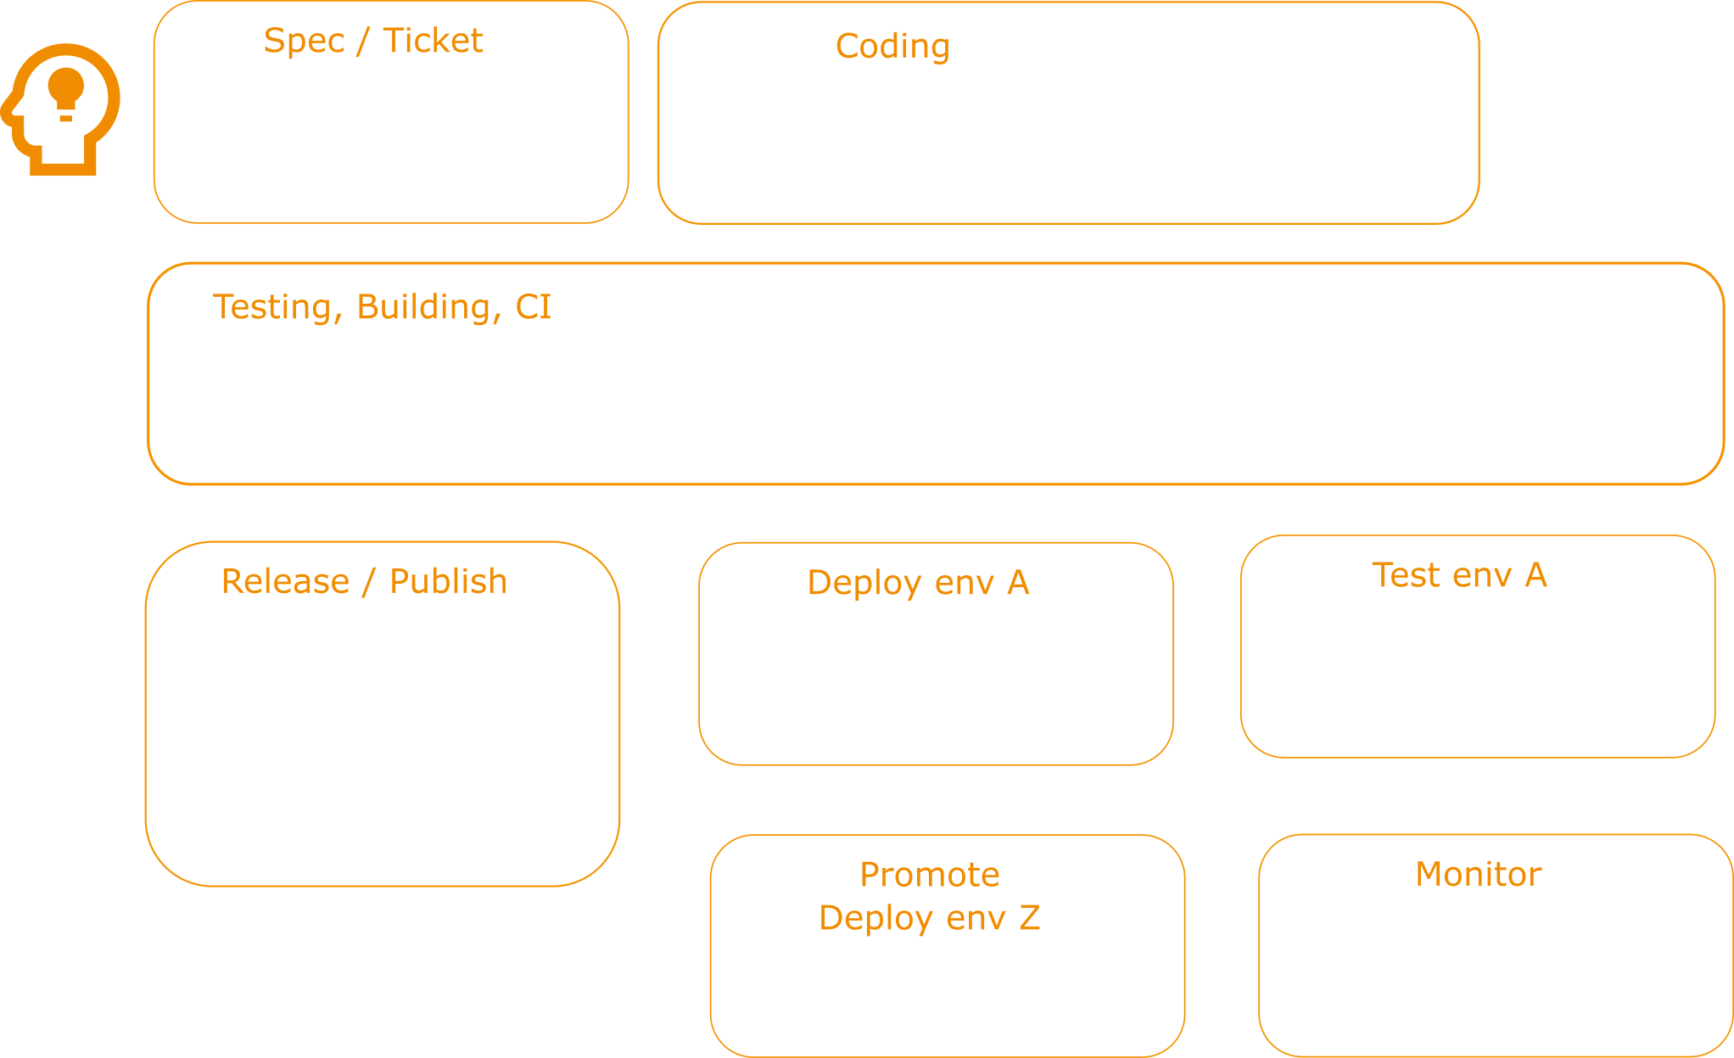
The Problem I Wanted to Solve

Slide 4
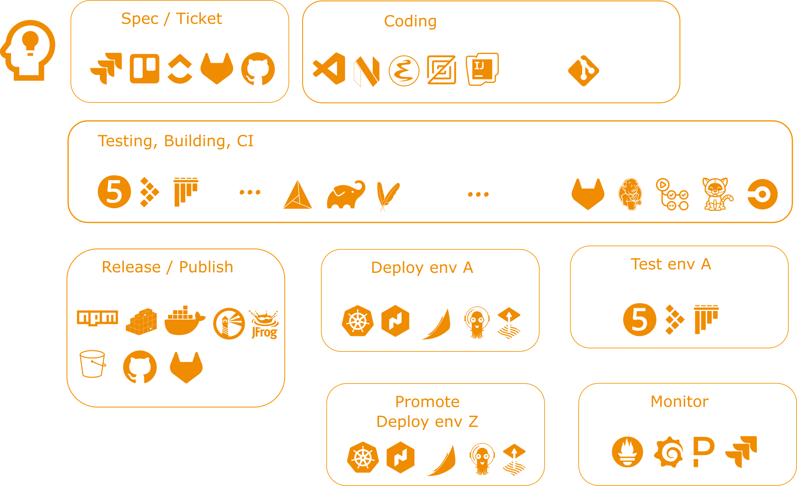
The Problem I Wanted to Solve
Notes:
- GitHub Actions logs here
- Jenkins builds there
- ArgoCD deployments somewhere else
- No unified view of deployment flow
**Question:** How do you measure deployment frequency across all your tools?

Slide 5

The bet: Standardization > short-term pragmatism
0.1 2022-10
0.2 2023-03
0.3 2023-05
0.4 2024-07
0.5 2025-12
Notes:
- 0.1 2022-10
- 0.2 2023-03
- 0.3 2023-05
- 0.4 2024-07
- 0.5 2025-12

Slide 6
The Reality Check
In 2023, CDEvents had:
- ❌ Minimal tool adoption
- ❌ No production deployments I knew of
- ❌ Specification still evolving
- ❌ Existing tools, do not expect existing tools to migrate (existing, richer, autonomous)
- ✅ Strong backing (CDF/Linux Foundation)
- ✅ Solving a real problem
Decision: Build anyway. Someone has to go first.

Slide 7
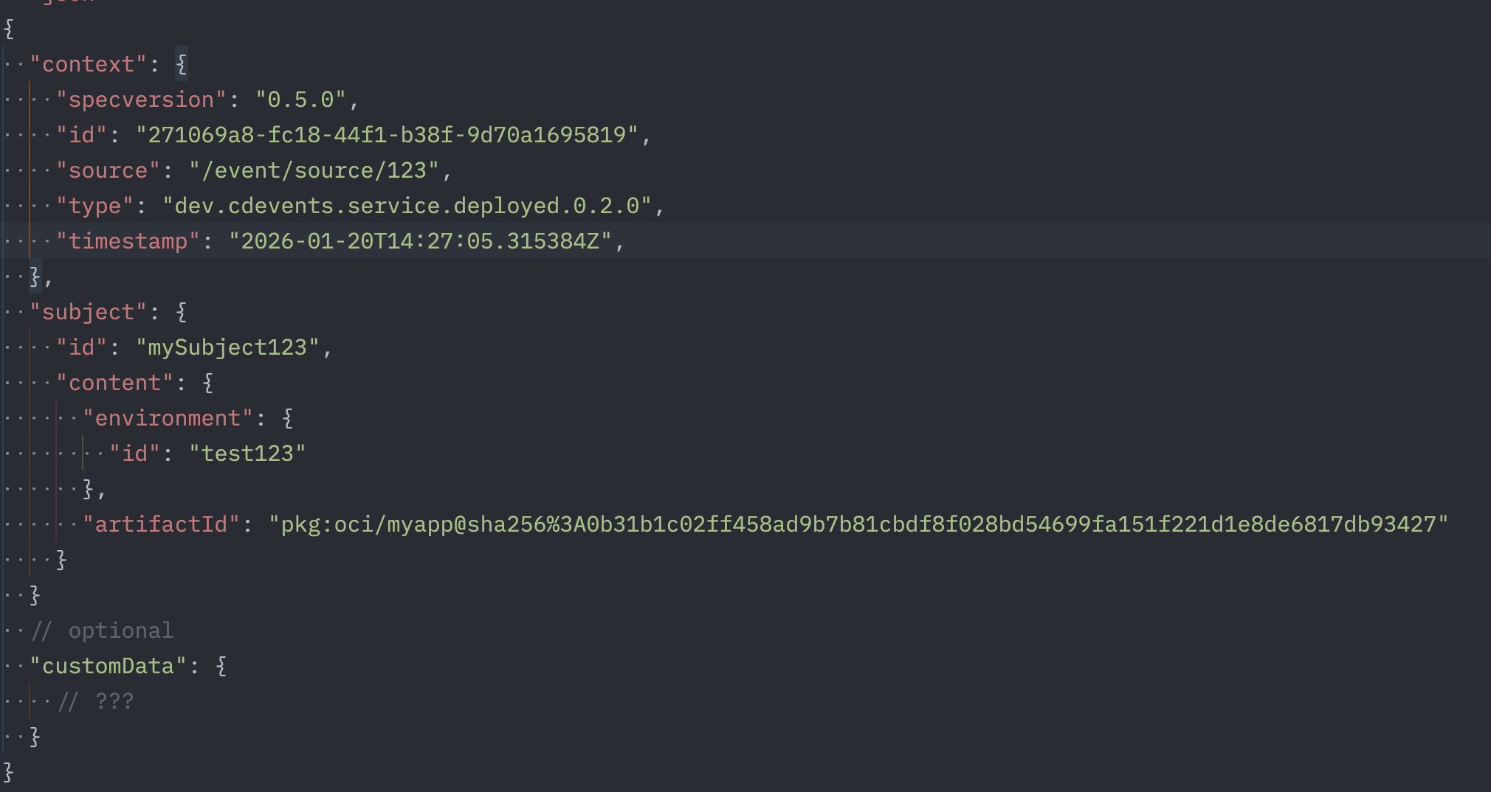
CDEvents format
CDEvents = vendor-neutral specification for Continuous Delivery events
Notes:
JSON (json schema)
Explain the 3 blocks: context, subject, customeData
Extensible, links, chainId

Slide 8
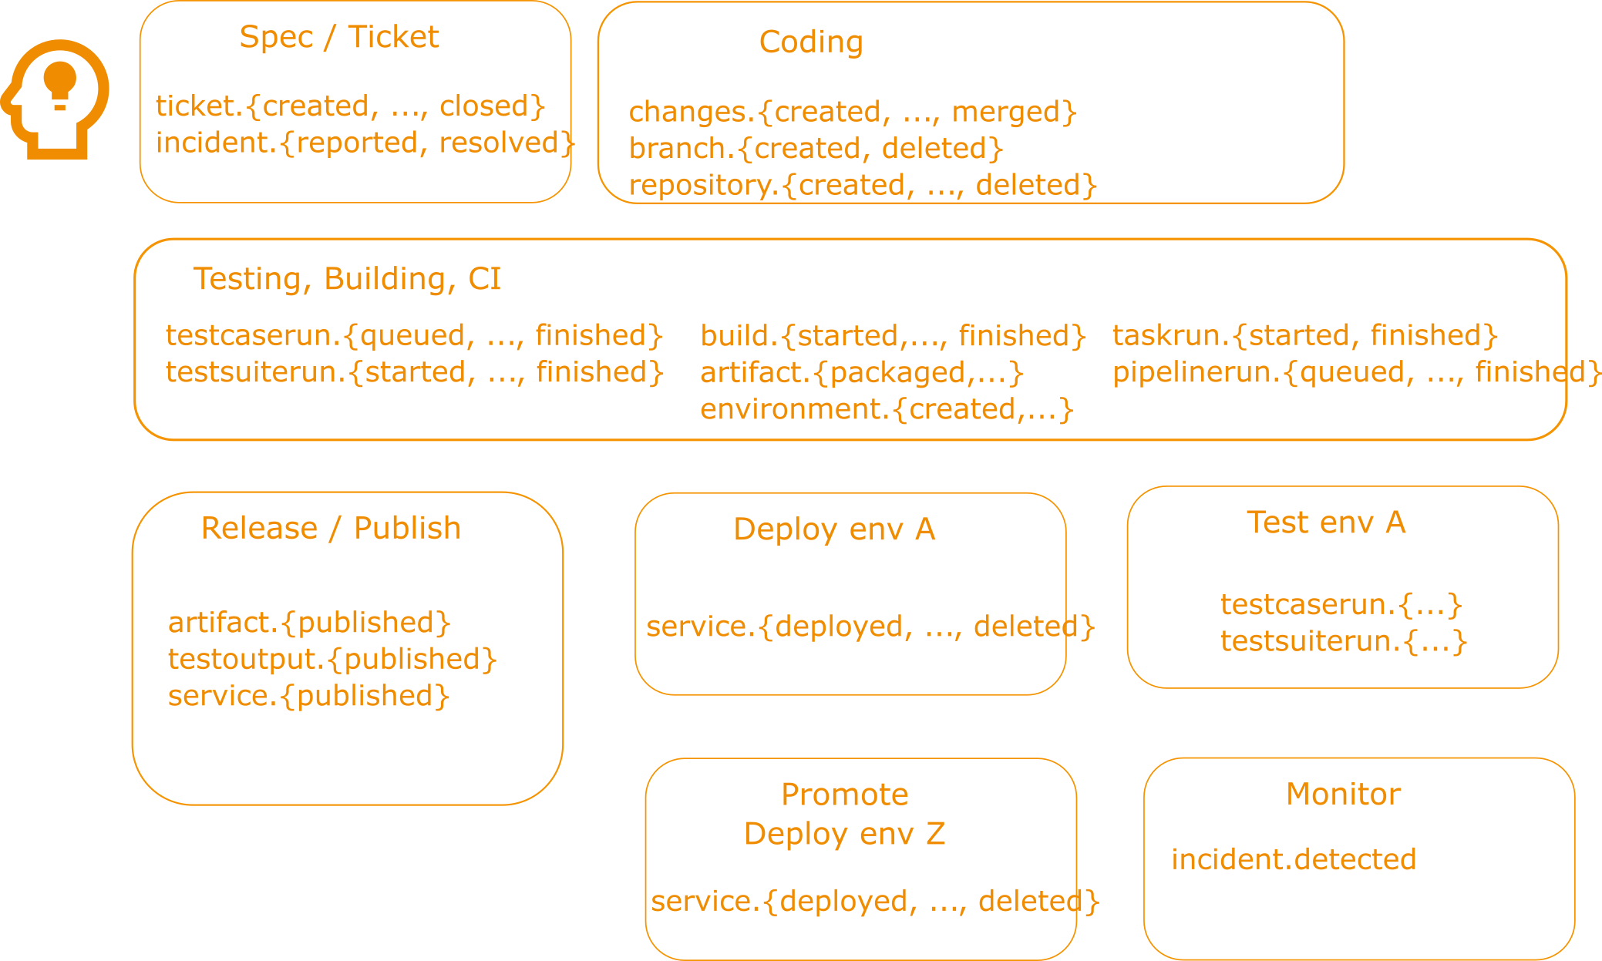
Subject & Predicate

Slide 9
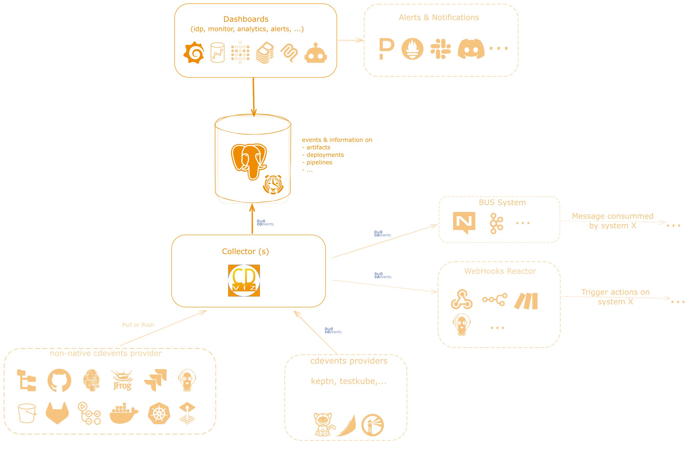
CDviz

Slide 10
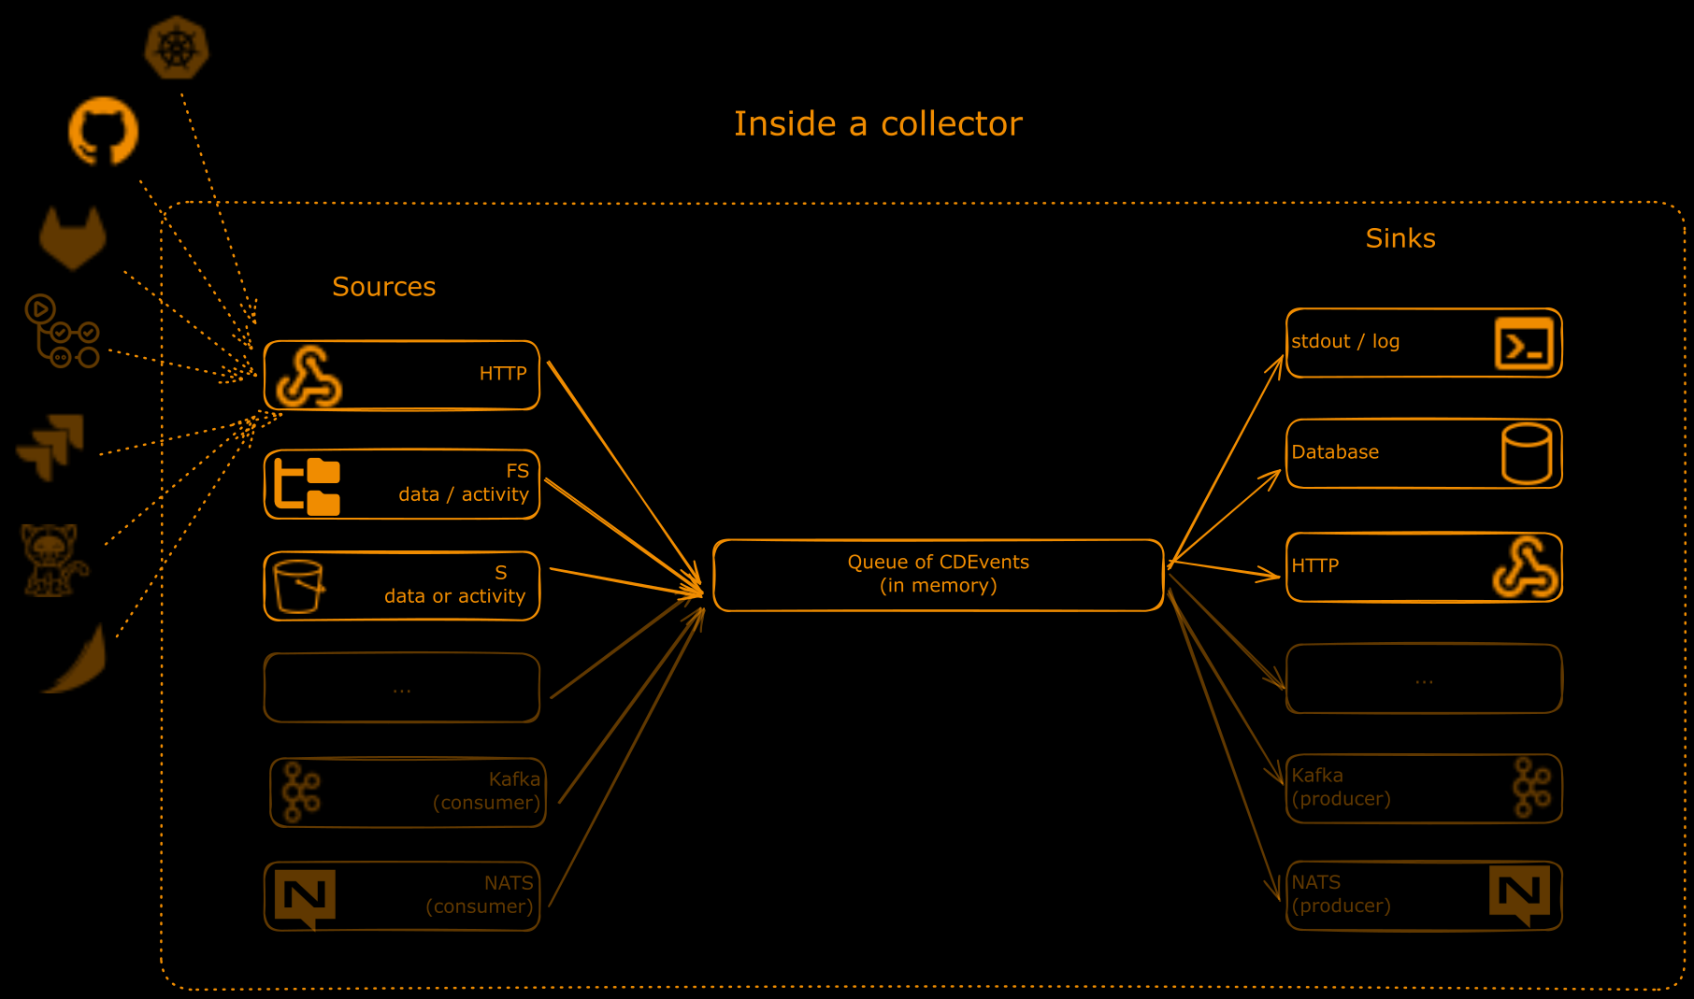

Slide 11
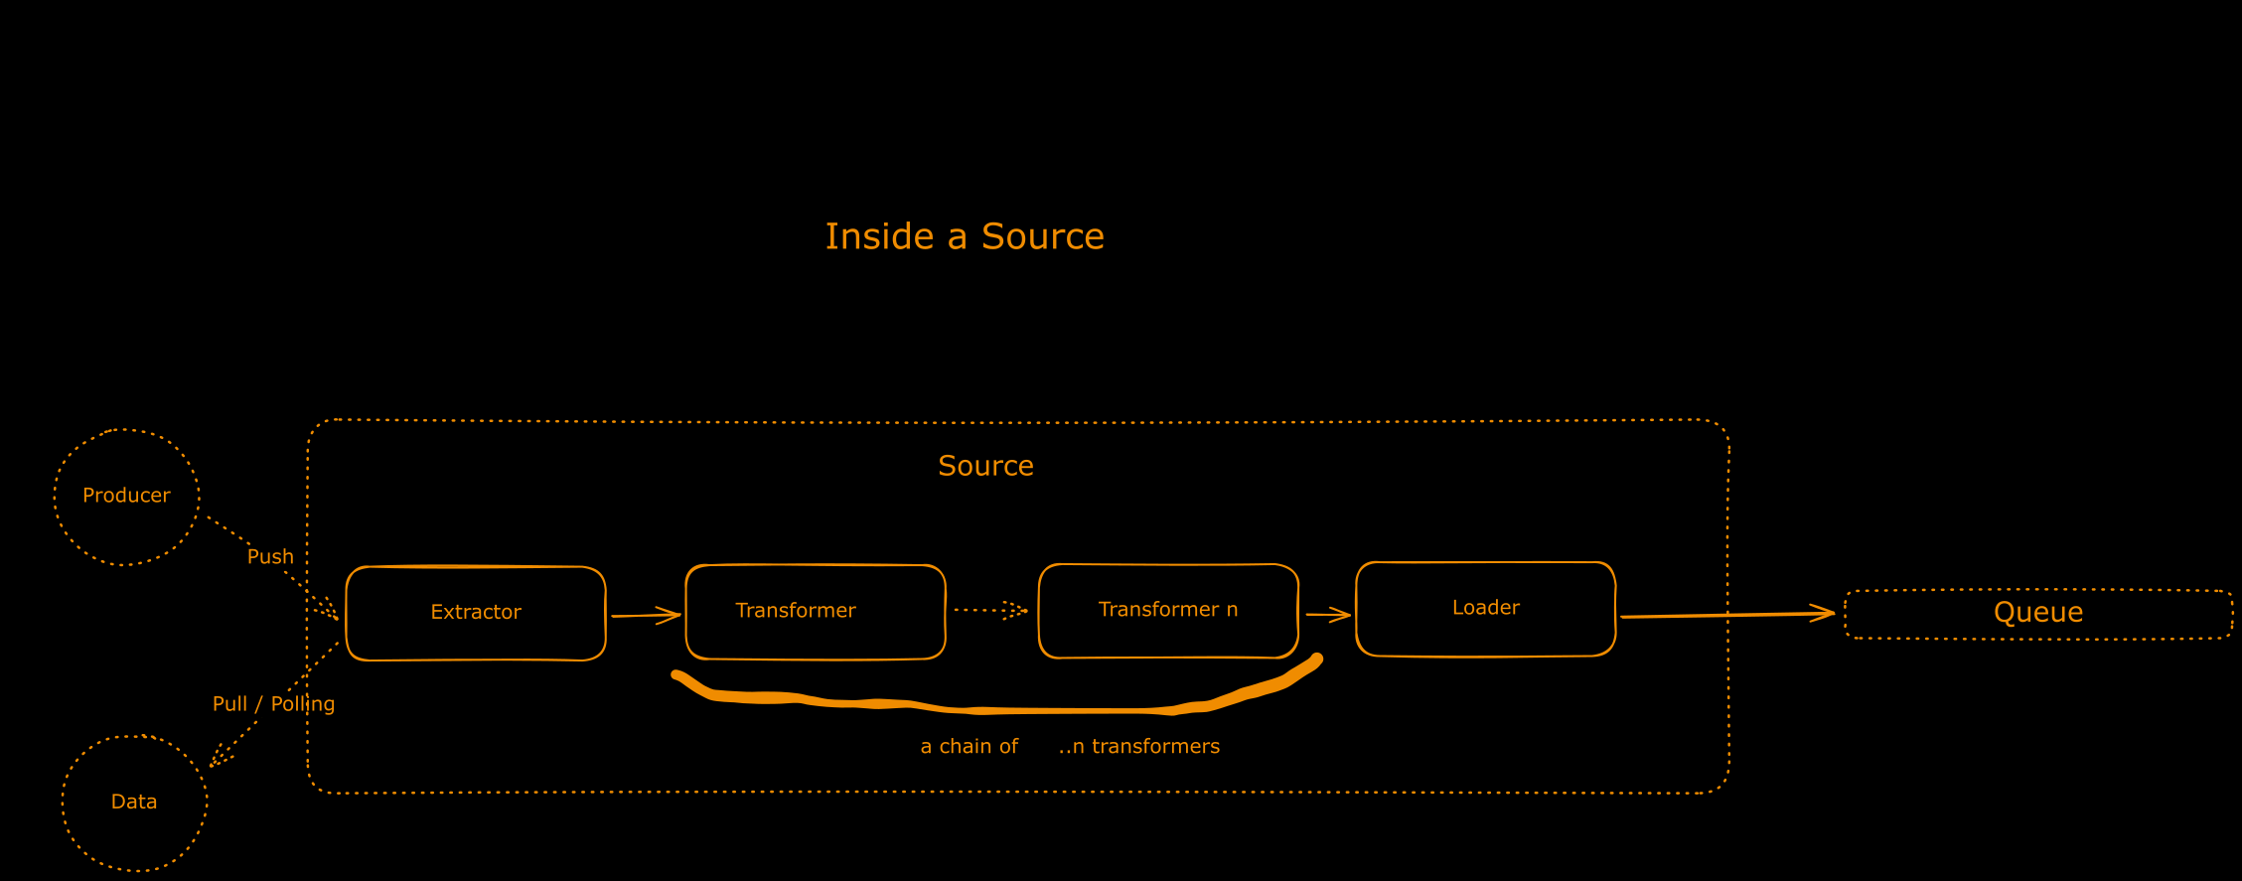

Slide 12
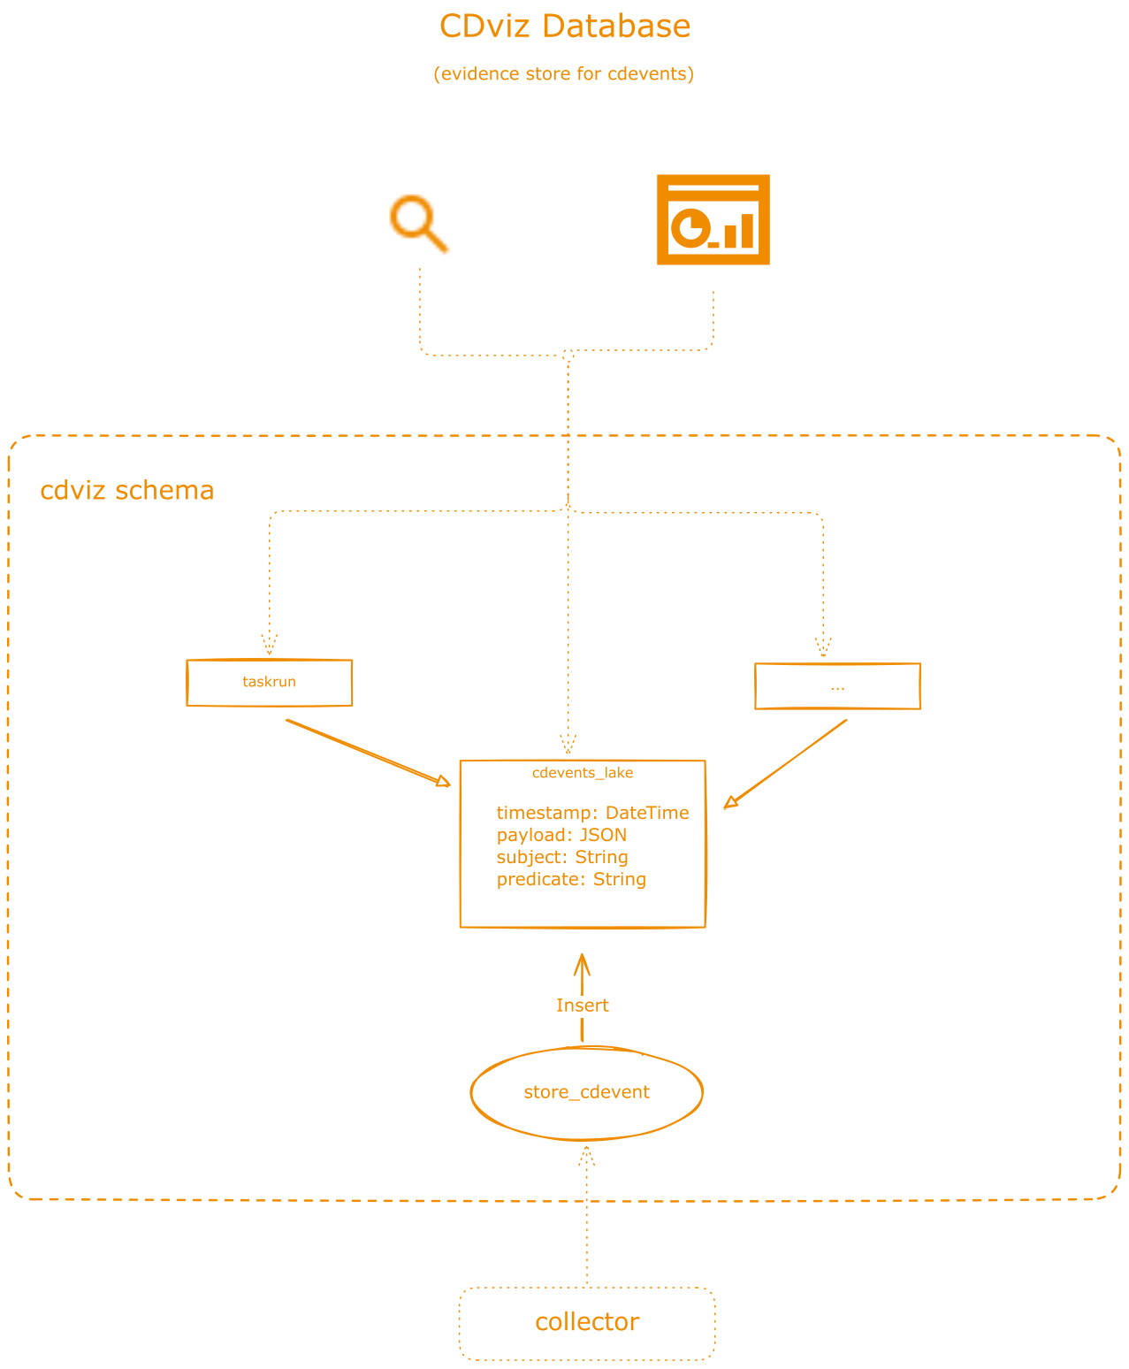
Notes:
Also named “evidence store”

Slide 13
What the Dashboard Shows
Key metrics:
- Deployment frequency by environment
- Promotion delays (dev → staging → prod)
- Pipeline duration trends
- (Soon) Test results and flaky test detection
Built with:
- Grafana dashboards
- PostgreSQL/TimescaleDB queries
- CDEvents as data source

Slide 14
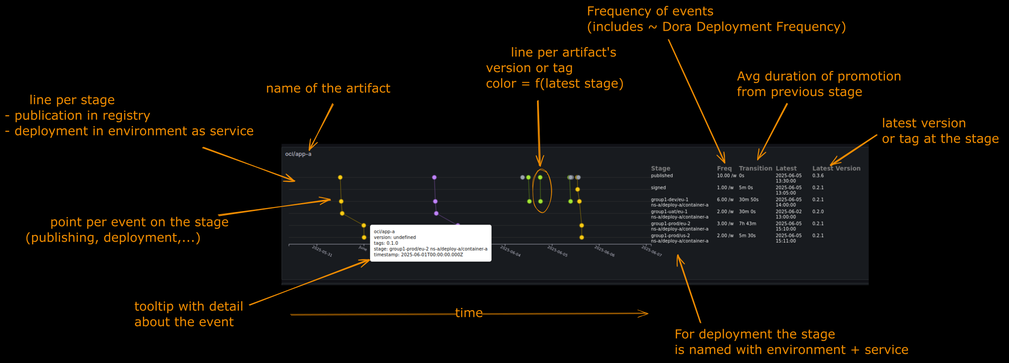
Notes:
Start by what is important for you, in my case I started by CD: lifecycle of artifact (version)
kubernetes, then github, argocd (can duplicate/conflict or become complementary with kubernetes) (that is different of what I wrote in the abstract of this talk)

Slide 15
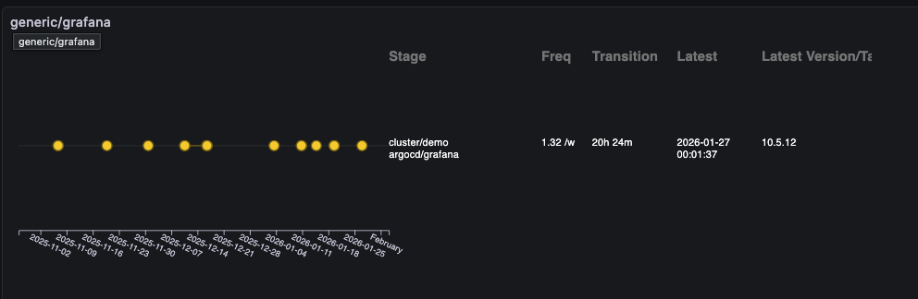
Notes:
Demo fallback

Slide 16
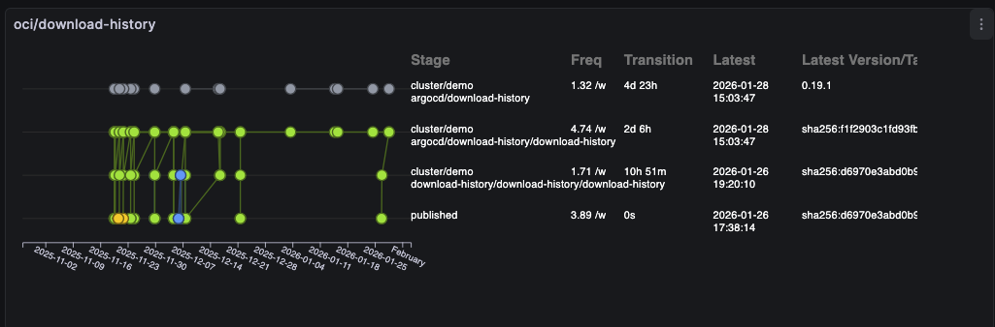
Notes:
Demo fallback

Slide 17
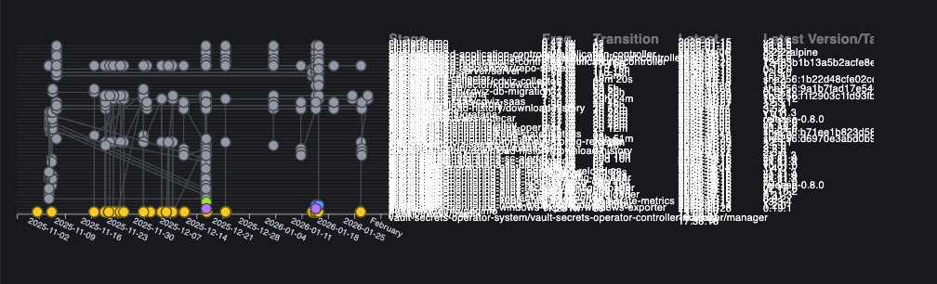
Notes:
Demo fallback

Slide 18
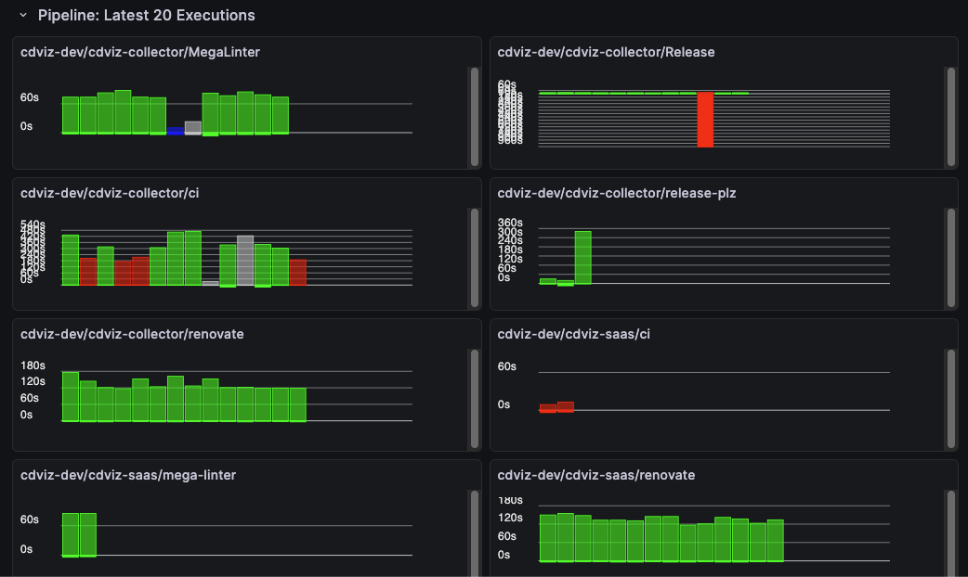
Notes:
Demo fallback

Slide 19
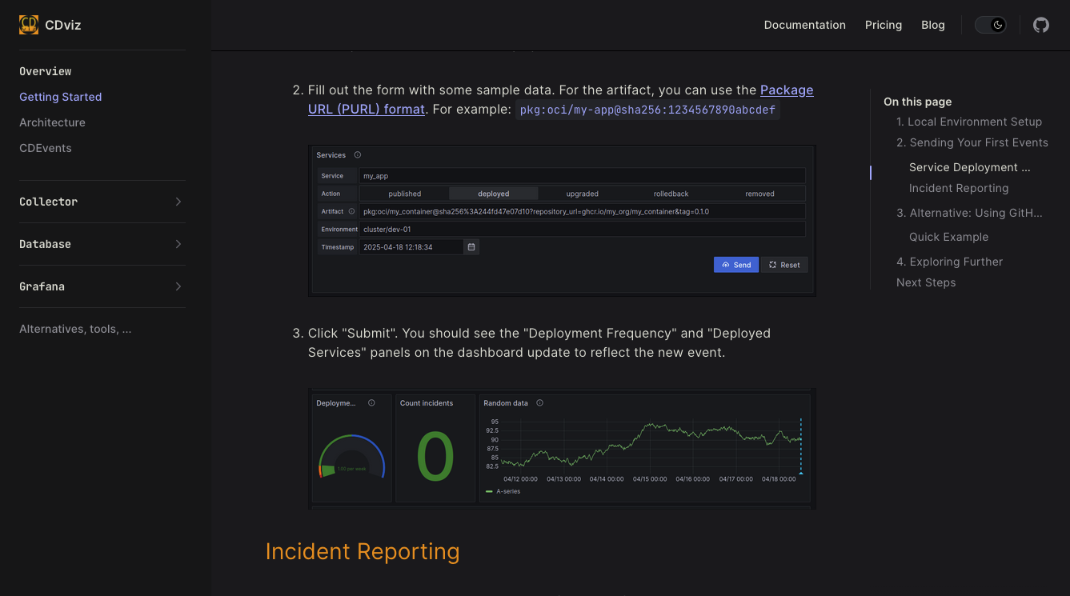
Getting Started
Notes:
Need to create documentation, on boarding (dockerr compose with demo data, and forms to simulate service deployement, incident reporting)

Slide 20
What Worked ✅
1. Bet on standards
- CDEvents will grow (even if slowly)
- Future-proofing is worth it
2. Start simple
- PostgreSQL over fancy time-series DB
- Grafana over custom UI
- MVP first, optimize later
3. Keep events raw
- Store original CDEvents
- Add views/aggregations later
- Don't lose information
4. Modular
- User can peek what he wants

Slide 21
What Didn't Work ❌
1. Waiting for ecosystem adoption
- I thought tools would add CDEvents support
- Reality: Had to build all the adapters myself
2. Perfect schema upfront
- Spent too long designing "the perfect" DB schema
- Should have iterated faster
3. Underestimating transformer complexity
- Each tool is a unique snowflake
- Adapters are 60% of the code

Slide 22
Challenges
Building on emerging spec
Correlate information/events
Dashboards for various audience (persona)
Data ownership
Target: organization with build capabilities
Documentation & marketing
Notes:
Correlation:
correlate a task with an artifact with a service,...
linking is the hard part, cdevents includes optional "chainId", “links & tags” as part of the context,... but like for distributed-tracing it means to propagate from input event to output events, currently not possible So ??? (correlate on id (artifactId), define rules based on names, company information,...)
use artifact Id (formatted into Package URL, non opaque) + rules
Documentation: animation are coming

Slide 23
Building on Emerging Specs
Pros:
- First-mover advantage
- Influence the specification
- Solve real problems early
- Experiment (best?) practices
Cons:
- You're the QA team
- Documentation is sparse
- Breaking changes happen
- Needs users feedback x2

Slide 24
Roadmaps
CDEvents:
- Fix 0.5.0
- Improve consistency
- ???
2026 (CDviz)
- Enhanced test dashboards
- More event sources, transformers, sinks
- Integrate feedbacks
CDviz beyond observability:
- Trigger workflows based on CDEvents
- Automation, not just observation
- Event-driven CI/CD
Vision: Make CDEvents the HTTP of CI/CD

Slide 25


Questions
https://cdviz.dev
Give it a Try & share your feedbacks
Notes:
Building on emerging standards is risky but rewarding. Someone has to go first.
CDEvents & CDviz are young, they doesn't fix all the problems but you can start to use them. We are looking for users, contributions, feedbacks, comments,... including "why is it useless for you? what is missing, what to improve,..."

